Slide 1
Learning Big Data
Aditya Konda
Big Data Engineer

Slide 2
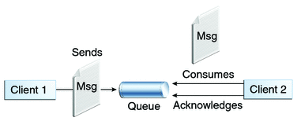
Content
Messaging System
Point- to-Point Messaging System
Point- to-Point Messaging Architecture
Publish Subscribe Messaging System
Publish Subscribe Messaging Architecture

Slide 3

Content
Apache Kafka
Key Benefits
Architecture
components
Kafka Distributed System Architecture
Kafka Workflow Architecture

Slide 4

Content
Apache Zookeeper
Introduction
Components
Architecture
Benefits

Slide 5
Messaging System
Challenges of Big Data
Collect large volume of data
Analyze the collected data
Messaging System
Responsible transferring data from one application to another
Point to Point Messaging System
Publish-Subscribe Messaging System

Slide 6
Point to Point Messaging System
Messages are persisted in a queue
Once a consumer reads a message in the queue, it disappears from that queue
Example
Order Processing System

Slide 7

Point-to-Point Messaging Architecture

Slide 8
Publish Subscribe Messaging System
Messages are persisted in a Topic.
Message producers are called Publishers.
Message consumers are called Subscribers.
Consumers can subscribe to one or more topic and can consume all messages in that topic.
Example:
Dish TV

Slide 9
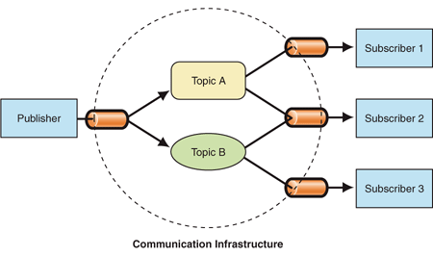
Publish-Subscribe Messaging Architecture

Slide 10
Apache Kafka
Developed by LinkedIn
A distributed publish-subscribe messaging system
Suitable for both offline and online message consumption
Messages are persisted on the disk and replicated
Built on top of the zookeeper

Slide 11
Kafka - Key Benefits
Reliability − distributed, partitioned, replicated and fault tolerance.
Scalability − scales easily without down time..
Durability − uses Distributed commit log which means messages persists on disk as fast as possible
Performance − maintains stable performance even many TB of messages are stored.

Slide 12
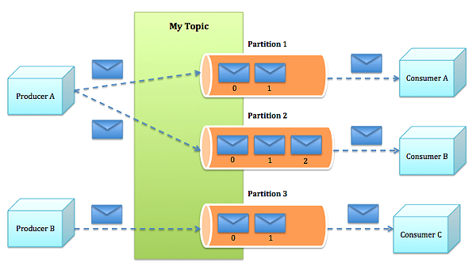
Kafka - Architecture

Slide 13
Kafka – Components
Partition Offset:
Each Partitioned Message Has A Unique Sequence Id Called As Offset.
Brokers:
Simple System Responsible For Maintaining The Published Data
May Have Zero Or More Partitions Per Topic.
Leader:
node responsible for all reads and writes for the given partition
Every partition has one server acting as a leader

Slide 14
Kafka – Components
Follower:
Follows Leader Instructions.
follower will automatically become the new leader when leader fails.
Kafka Cluster:
Having More Than One Broker
Expanded Without Downtime.
Manage The Persistence And Replication Of Message Data.

Slide 15
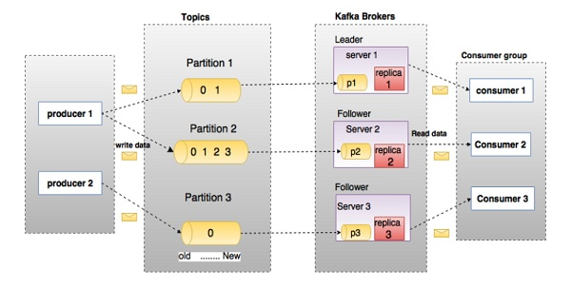
Kafka – Distributed System Architecture

Slide 16
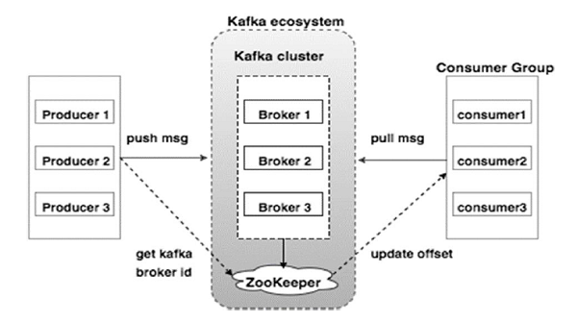
Kafka – Workflow Architecture

Slide 17
Zookeeper
Developed by Yahoo.
Coordinating and managing a service in a distributed environment.
allows developers to focus on core application logic.
standard for organized service used by Hadoop and other distributed frameworks.
Example:
Hbase, Solr(Search Engine), Kafka.

Slide 18
Zookeeper – Components
Clients Nodes:
Are The Nodes In A Cluster Accessing Information From Server.
Client Sends Heartbeat To Servers To Know Its Status.
Server Sends An Acknowledgement When A Client Connects.
Leader Nodes:
Responsible For Processing The Write Requests.
Leader Node Is Elected By The Follower Nodes.
It Is Recommended To Have An Odd Number Of Znodes In A Cluster.

Slide 19
Zookeeper – Components
Follower Nodes:
Other Than Leader Are Called Follower Nodes
Capable Of Servicing Read Requests. Write Request Are Done Through The Leader Node
Followers Plays A Key Role In Electing The New Leader Node When It Goes Down
Ensemble:
Group Of Zookeeper Servers
Minimum Number Of Nodes That Is Required To Form An Ensemble Is 3
Recommended To Have Odd Number Of Nodes In A Cluster.

Slide 20
Zookeeper – Components
Atomic Broadcast:
Present In Both Leader Node And Follower Nodes
Responsible For Broadcasting The Changes To Other Nodes (In Leader Node)
Receiving The Change Notification (In Follower Nodes).
Request Processor:
Component Is Only Active In Leader Node
Responsible For Processing Write Requests Originating From Client Or Follower Nodes
After Write Process It Broadcasts The Changes To Follower Nodes

Slide 21
Zookeeper – Components
In-memory database (replicated database):
Responsible for storing the data in zookeeper
Every node contains its own database that enables them to server read requests
Written to file system providing recoverability

Slide 22
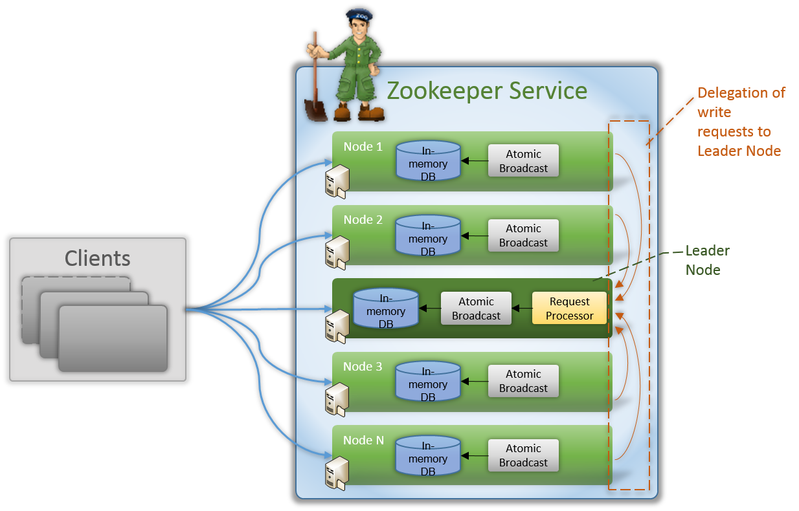
Zookeeper – Architecture

Slide 23
Zookeeper – Benefits
Simple Design
Fast Processing
Data Replication
Atomic and Ordered Updates
Reliability

Slide 24
References
Brief Introduction about Zookeeper
Detail description about Zookeeper
Zookeeper tutorials

Slide 25
References
Messaging System
Point-to-Point Messaging System
RabbitMQ Messaging System
Apache Kafka

Slide 26


